Slide 1

Java Spring Basic
HuyNQ12@topica.edu.vn
‹#›

Slide 2
Spring - Overview
"Spring" means different things in different contexts
The Spring Framework is divided into modules, applications can choose which modules they need.
The Spring Framework provides foundational support for different application architectures
messaging
transactional data and persistence
web
servlet-based Spring MVC web framework
Spring WebFlux reactive web framework
Came into being in 2003 as a response to the complexity of the early J2EE specifications
Integrates with carefully selected individual specifications from the EE umbrella: Servlet API (JSR 340), WebSocket API (JSR 356), Concurrency Utilities (JSR 236), JSON Binding API (JSR 367), Bean Validation (JSR 303), JPA (JSR 338), JMS (JSR 914), Dependency Injection (JSR 330), Common Annotations (JSR 250)
As of Spring Framework 5.0, Spring requires JDK 8+ (Java SE 8+), Spring requires the Java EE 7 level (e.g. Servlet 3.1+, JPA 2.1+) as a minimum
‹#›
Notes:
At the heart are the modules of the core container, including a configuration model and a dependency injection mechanism
While some consider Java EE and Spring to be in competition, Spring is, in fact, complementary to Java EE

Slide 3
Spring - Design Philosophy
Provide choice at every level
Accommodate diverse perspectives
Maintain strong backward compatibility
Care about API design
Set high standards for code quality
‹#›
Notes:
At the heart are the modules of the core container, including a configuration model and a dependency injection mechanism
While some consider Java EE and Spring to be in competition, Spring is, in fact, complementary to Java EE
https://docs.spring.io/spring/docs/current/spring-framework-reference/overview.html

Slide 4
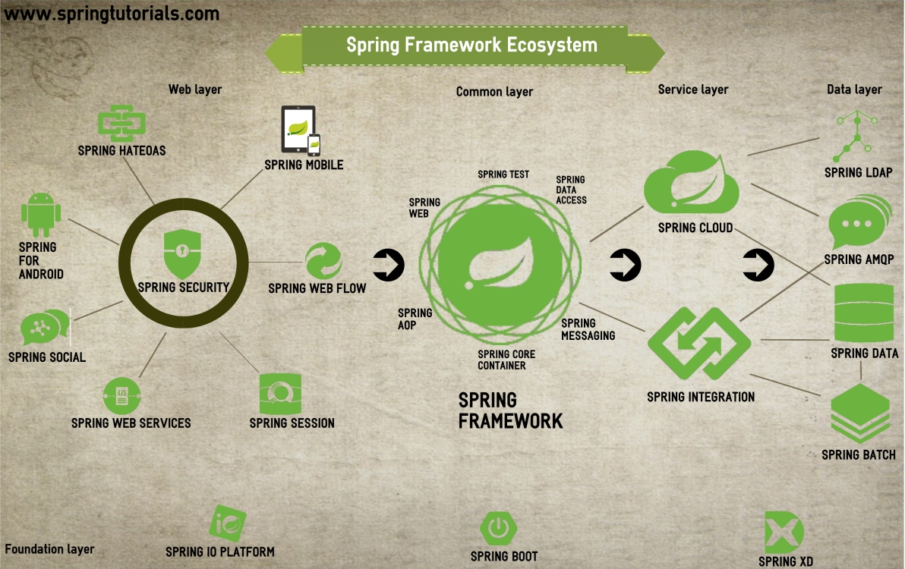
‹#›

Slide 5
Spring - The IoC container - Container overview
IoC (Inversion of Control) is also known as dependency injection (DI), it is a process whereby
objects define their dependencies (the other objects they work with)
through constructor arguments
arguments to a factory method
or properties that are set on the object instance after it is constructed
or returned from a factory method
the container then injects those dependencies when it creates the bean
In Spring, the objects that form the backbone of your application and that are managed by the Spring IoC container are called beans
The interface org.springframework.context.ApplicationContext represents the Spring IoC container and is responsible for instantiating, configuring, and assembling the aforementioned beans
‹#›
Notes:
The container gets its instructions on what objects to instantiate, configure, and assemble by reading configuration metadata. The configuration metadata is represented in XML, Java annotations, or Java code.
In standalone applications it is common to create an instance of ClassPathXmlApplicationContext or FileSystemXmlApplicationContext
https://docs.spring.io/spring/docs/current/spring-framework-reference/core.html

Slide 6
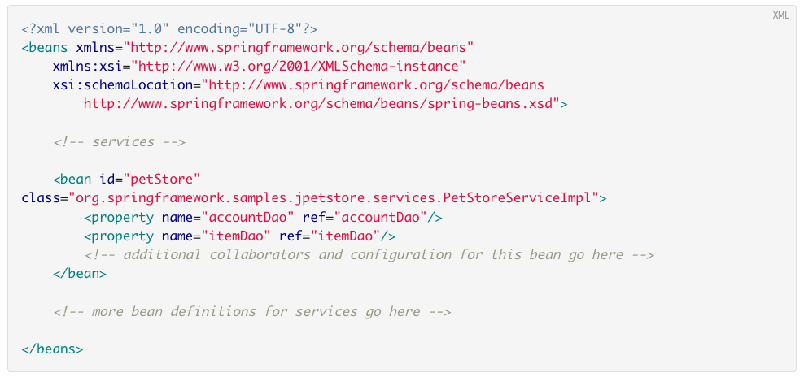
‹#›

Slide 7
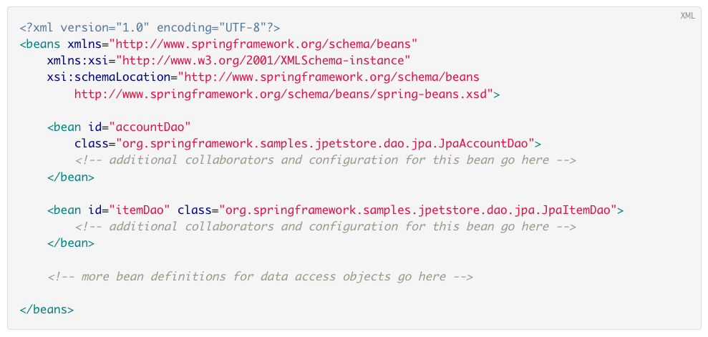
‹#›

Slide 8
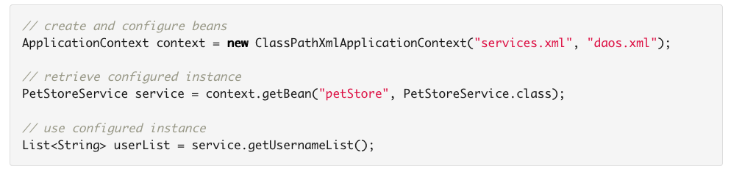
‹#›

Slide 9
Spring - The IoC container - Bean overview
Bean definitions are represented as BeanDefinition objects, which contain (among other information) the following metadata
A package-qualified class name: typically the actual implementation class of the bean being defined
Bean behavioral configuration elements, which state how the bean should behave in the container (scope, lifecycle callbacks, and so forth)
References to other beans that are needed for the bean to do its work; these references are also called collaborators or dependencies
Other configuration settings to set in the newly created object, for example, the number of connections to use in a bean that manages a connection pool, or the size limit of the pool
Every bean has one or more identifiers. These identifiers must be unique within the container that hosts the bean
‹#›
Notes:
In XML-based configuration metadata, you use the id and/or name attributes to specify the bean identifier(s). The id attribute allows you to specify exactly one id. Conventionally these names are alphanumeric ('myBean', 'fooService', etc.), but may contain special characters as well

Slide 10
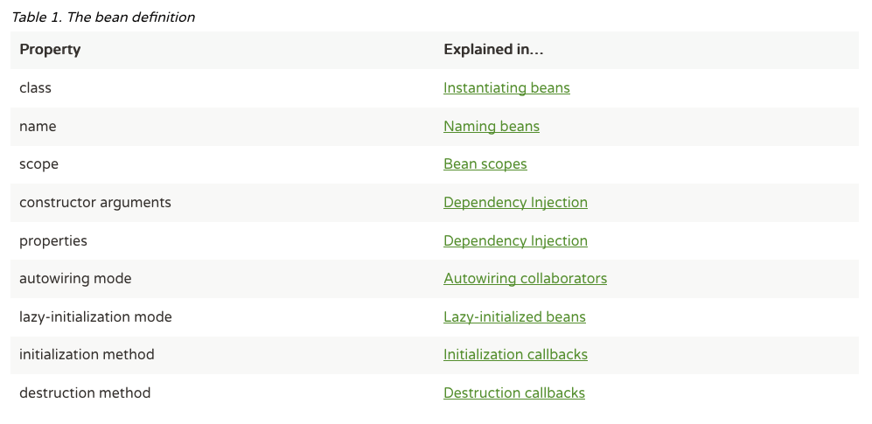
‹#›

Slide 11
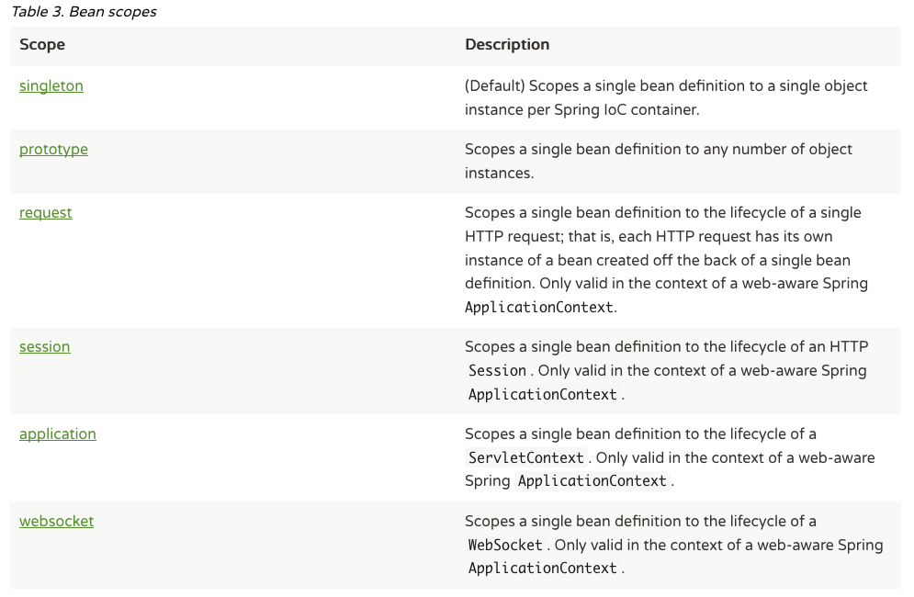
‹#›
Notes:
As a rule, use the prototype scope for all stateful beans and the singleton scope for stateless beans.

Slide 12
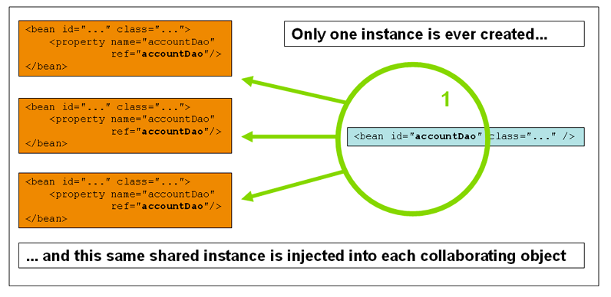
‹#›
Notes:
As a rule, use the prototype scope for all stateful beans and the singleton scope for stateless beans.

Slide 13
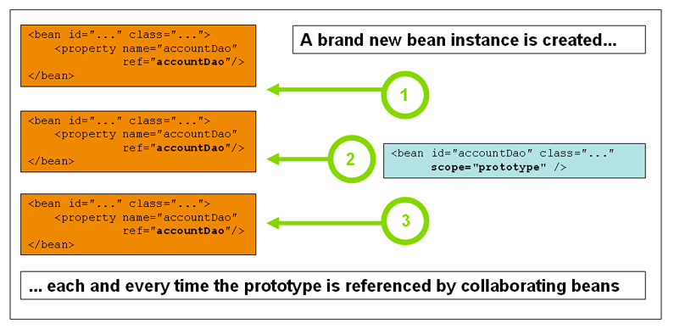
‹#›
Notes:
As a rule, use the prototype scope for all stateful beans and the singleton scope for stateless beans.

Slide 14
Spring - The IoC container - Dependency Injection
Code is cleaner with the DI principle and decoupling is more effective when objects are provided with their dependencies
The object does not look up its dependencies, and does not know the location or class of the dependencies
DI exists in two major variants
Constructor-based dependency injection
Setter-based dependency injection
The Spring container can autowire relationships between collaborating beans
‹#›

Slide 15

‹#›

Slide 16
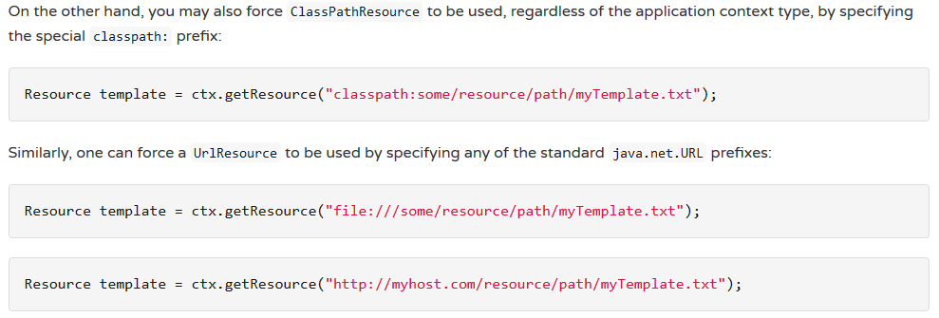
Spring - Resources
Built-in Resource implements
UrlResource
ClassPathResource
FileSystemResource
ServletContextResource
InputStreamResource
ByteArrayResource
‹#›

Slide 17
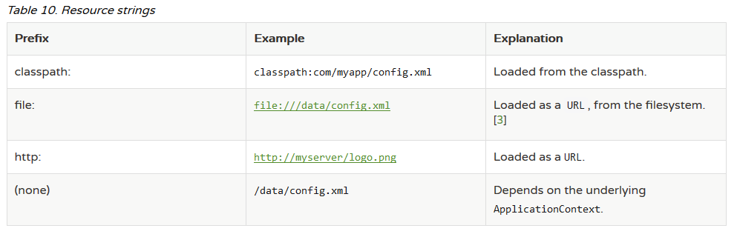
‹#›

Slide 18
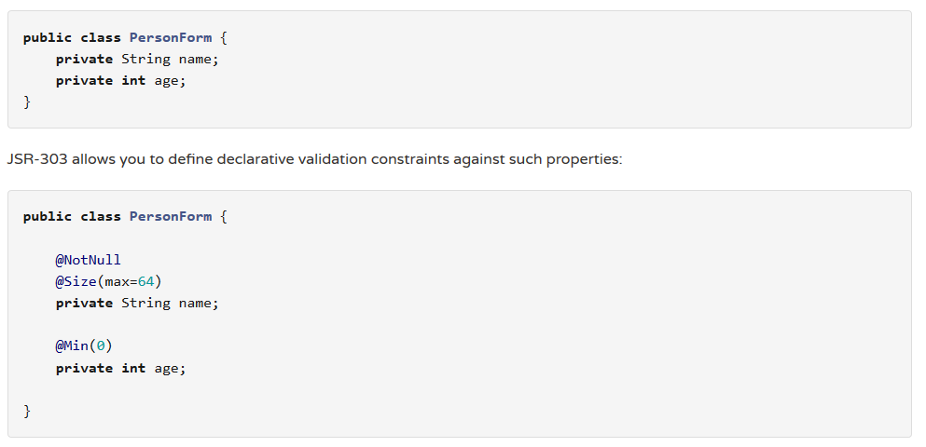
Spring - Validation, Data Binding, and Type Conversion
‹#›

Slide 19
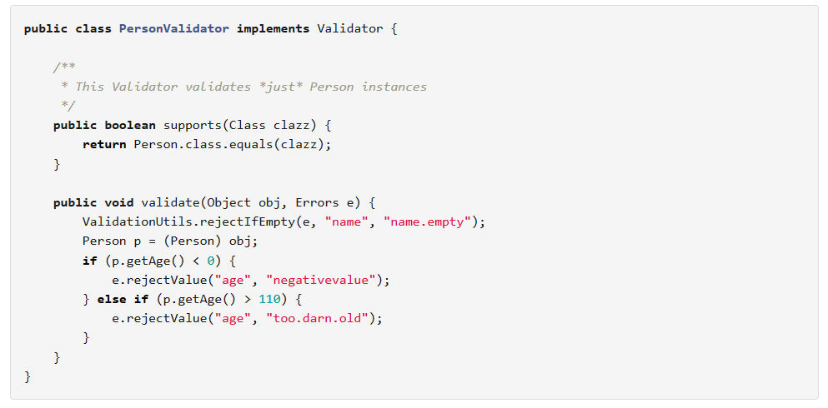
‹#›

Slide 20
Spring - Spring Expression Language (SpEL)
A powerful expression language that supports querying and manipulating an object graph at runtime
DEMO
‹#›

Slide 21
Spring - AOP - Cross Cutting Concerns
Applications are generally developed with multiple layers. A typical Java application has
Web layer
Business layer
Data layer
While the responsibilities of each of these layers are different, there are a few common aspects that apply to all layers
Logging
Security
→ These common aspects are called Cross Cutting Concerns
‹#›

Slide 22
Spring - AOP - Implement cross cutting concerns
If you would want to log every request to a web application, what are the options you can think of?
If you would want to track performance of every request, what options can you think of?
DEMO AOP
‹#›

Slide 23
Spring - AOP - Terminology
Pointcut - Pointcut is the expression used to define when a call to a method should be intercepted
Advice - What do you want to do? It is the logic that you would want to invoke when you intercept a method
Aspect - A combination of defining when you want to intercept a method call (Pointcut) and what to do (Advice) is called an Aspect
Join Point - When the code is executed and the condition for pointcut is met, the advice is executed. The Join Point is a specific execution instance of an advice
Weaver - Weaver is the framework which implements AOP - AspectJ or Spring AOP
‹#›
Notes:
http://www.baeldung.com/spring-aop-pointcut-tutorial

Slide 24
Spring - AOP - Interception
@After - Executed in two situations - when a method executes successfully or it throws an exception
@AfterReturning - Executed only when a method executes successfully
@AfterThrowing - Executed only when a method throws an exception
@Around - Uses an around advice. Intercepts the method call and uses joinPoint.proceed() to execute the method
@annotation(net.friend.TrackTime) - Pointcut to define interception based on an annotation - @annotation followed by the complete type name of the annotation
‹#›

Slide 25

‹#›

Slide 26
Task
Build an application use Spring Framework 5.x (Sring boot 2.x)
Business requirements:
Allow user search by type in Vietnamese
Allow search by “tiếng Việt có dấu hoặc không dấu”
Technical requirement
Use IoC, Resources, Validation, Type Conversion, SpEL
Bonus: build application use Spring MVC and use Spring MVC Validation
‹#›

Slide 27
Task
Build an application use Spring Framework 5.x (Sring boot 2.x)
Business requirements:
Read data from local file, database
Convert data from unicode to ASCII
Insert output to database
Technical requirement
Use IoC, Type Conversion, Spring Integration
Test requirement:
Input local file address: D:/_tmp/input.txt
Input database address: 127.0.0.1:3306/ai-lab
Input database account: root/123456a@A
Input database table:
Name: spring_integration_input
Columns: id (bigint, PK), content (varchar 1000)
Output file address: D:/_tmp/output.txt
‹#›

Slide 28
Task
Build an application use AOP of Spring Framework 5.x (Spring boot 2.x)
Business requirements:
Write a function to sum of 2 elements (String) , example: “2”, “3” --: output “5”
String sum(String first, String second) Class MySum
Class MyAop
Technical requirement
Use AOP to check input, if input not numeric then return “N/A”
‹#›

